Slide 1
Casual to Usual
Cyclistic marketing strategy design --
base on behavior study of different user types

Slide 2

This presentation is mainly made for the stock holders/ management of the company.
Information about the company and situation won’t included. For viewer who is not
aware of the purpose of this study, here is a brief introduction of the situation:
Cyclistic is a bike-share company features more than 5,800 bicycles and 600 docking stations in Chicago.
The director of marketing, Lily Moreno believes the company’s future success depends on maximizing the number of annual memberships. So she seeks help from data analytics team to understand differences between members and casual users behavior, and from there give suggestion to design a new marketing strategy to convert casual riders into annual members.

Slide 3
GOAL
What we are aiming to achieve from this study ?

Slide 4
Goal for this study is ...
To support design a Marketing Strategy
aiming at Converting
Casual Riders into Annual Members

Slide 5
To achieve our goal, we need to understand:
How do annual members and casual riders use Cyclistic bikes differently?
Why would casual riders buy Cyclistic annual memberships?
How can Cyclistic use digital media to influence casual riders to become members?

Slide 6
Prepare Data
Prepare : integrity/ info security
Process : clean / unite
Overall meta data rundown

Slide 7
Source and integrity
Information security
Data that we use does not contain any personal information, witch more or less affect our ability to understand correlation between data, but can ensure the study does not violate any privacy policy, and the analyzation is bias free.
The data is first hand data collected by Cyclistic.
There is no bias when collecting data. No value is filtered, limited when collected.
Date contain current trip and station information collecting from late 2013 to 2023.

Slide 8




Cleaning data
Checking for missing value, incorrect value, data type or format.
Percentage
Notes:
Checking for missing value, incorrect value, data type or format.
We drop the unusable data that contain incorrect value or format. For data like station ID/station name, we check if we can use foreign key for station data to fix the missing value before dropping the value.
Remove trip data that is coming from or going to charging station.
Trip going to and coming from a charging station should not be counted as part of customer data.
Setting conditions to filter unreasonable trip duration.
We only collect data with trip duration higher than 5 minutes and lower then 2 hours, to ensure the data can represent the user.

Slide 9



Cleaning data
Remove trip data that is not used by customers.
Setting conditions to filter unreasonable scenario.
5 mins
2 hours
Notes:
Checking for missing value, incorrect value, data type or format.
We drop the unusable data that contain incorrect value or format. For data like station ID/station name, we check if we can use foreign key for station data to fix the missing value before dropping the value.
Remove trip data that is coming from or going to charging station.
Trip going to and coming from a charging station should not be counted as part of customer data.
Setting conditions to filter unreasonable trip duration.
We only collect data with trip duration higher than 5 minutes and lower then 2 hours, to ensure the data can represent the user.

Slide 10
Intergrade and Organize
Intergrade
Make sure all format, column name from same type of data is united.
For example: In trip data, change all ‘from_station’ to ‘start_station’, so the column name is the same between data set.
Organize
Using Google cloud and Bigquery to manage data base and set up file naming rule.
Also keeping a local copy as backup.

Slide 11
Data summarize
After processing, we have two type of data: Trip data contain information in a single trip includes start and end station/time, location, user type and bike type. Station data record station name and id, location(latitude and longitude), capacity and online date.

Slide 12
Data summarize
We will be using two different time period of data for analytic study.
One period is from 2013 – 2023, which is all the data we have since company started.
The other is from 2022 July – 2023 June, this will represent more current information.

Slide 13
Analyze Data
Analyze Combine data, Explain and Visualize.

Slide 14
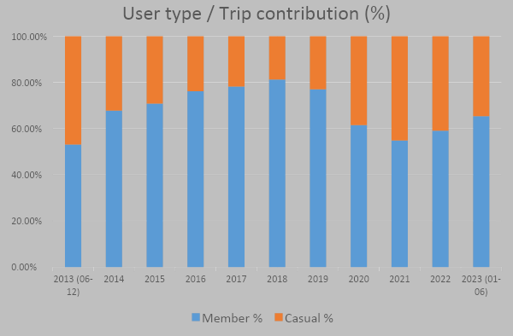
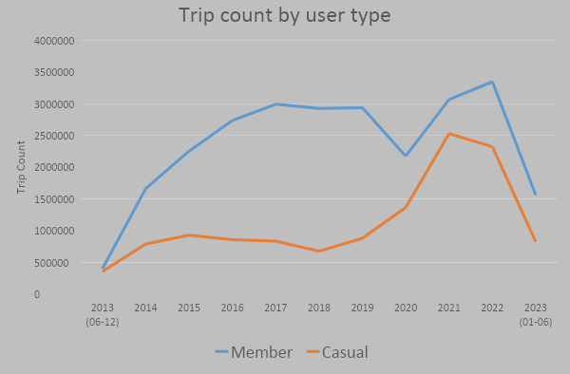
Analyze – User type
Big growth in casual rider since 2020, while member usage taken a hit due to Covid.
This casual rider growth means the contribution of our customer has change over years, and now we want to convert this new group of casual rider into long-tern member.

Slide 15
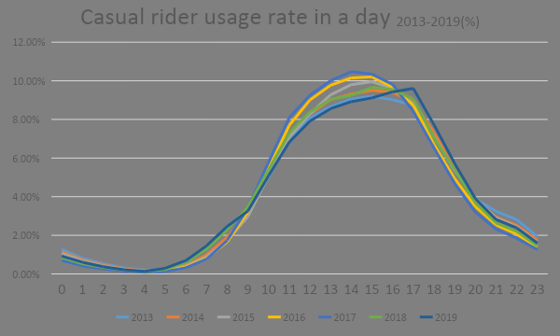
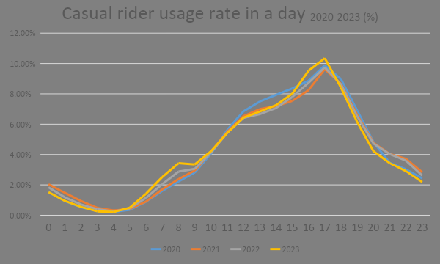
Analyze – Usage rate in a day (trend)
We can also see the different from past years data, our target group like to ride a little latter in the day around afternoon, with one obvious peak at 5 PM, which might indicate the customer are more likely to use the bike for one way instead of round trip.

Slide 16
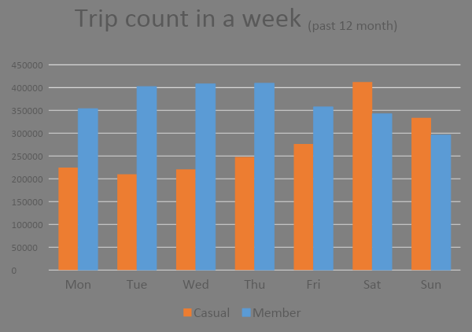
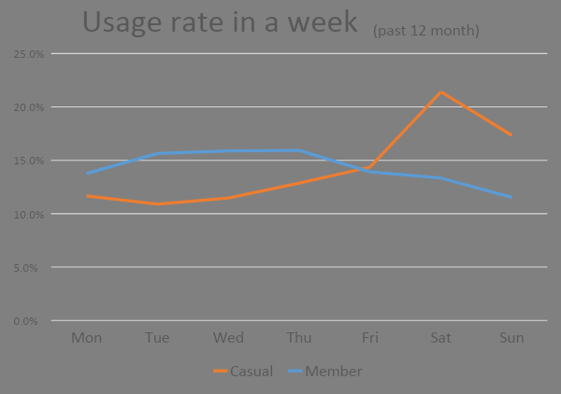
Analyze – Usage rate in a week
Compare to member, most of casual rider use the bike on weekend, likely for recreation purpose.
This also mean casual rider might not use the bike as often as member does.

Slide 17
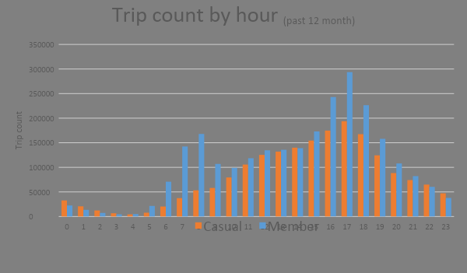
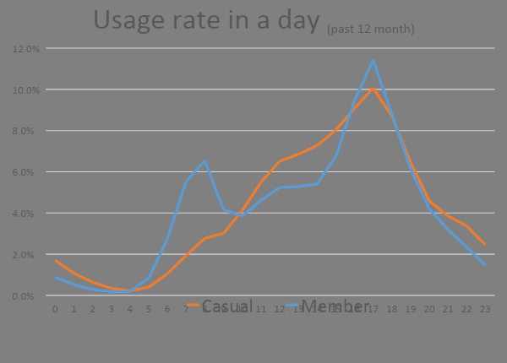
Analyze – Usage rate in a day
Different peek hour in a day also support our speculation: Most casual rider use the bike on weekend/ after work for recreation activities.

Slide 18




Analyze – Station popularity
We also check the casual rider’s most used / visited station, which further confirm our speculation.
Theater on the Lake
Millennium Park
Adler Planetarium
Shedd Aquarium

Slide 19
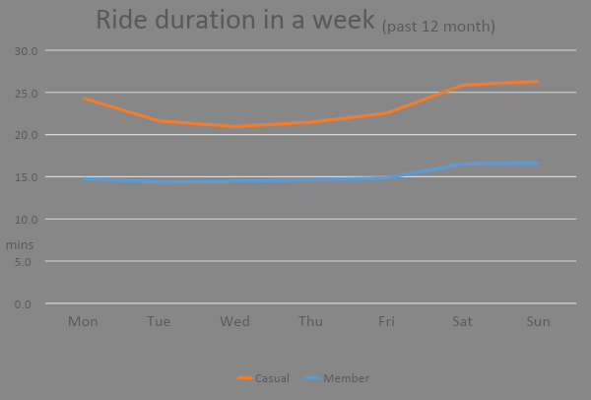
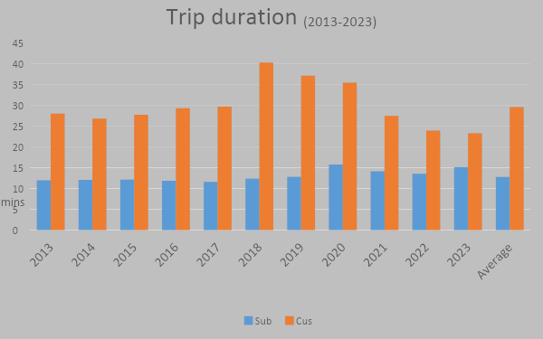
Analyze – Ride Duration
The average rides duration of casual rider is about 23 minutes. The duration is getting shorter since 2018, and duration is slightly higher on weekends.
Median point of casual rider duration(past 12 months),13 minutes , is about the same as member average, indicate .

Slide 20
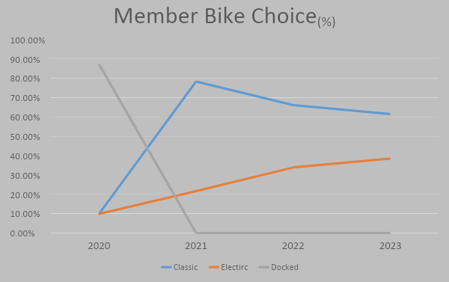
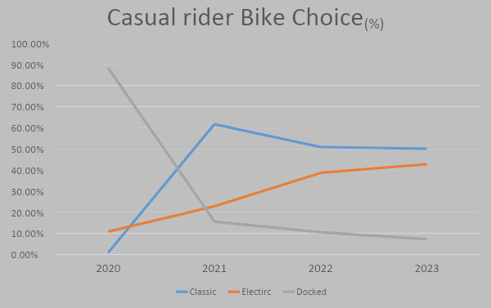
Analyze – Bike type Popularity
Most customer are choosing electric and classic bike over docked bike since the introduction of classic and electric bike.
While classic is still the most popular choice, electric bike seen to be the only bike that is growing in popularity.

Slide 21
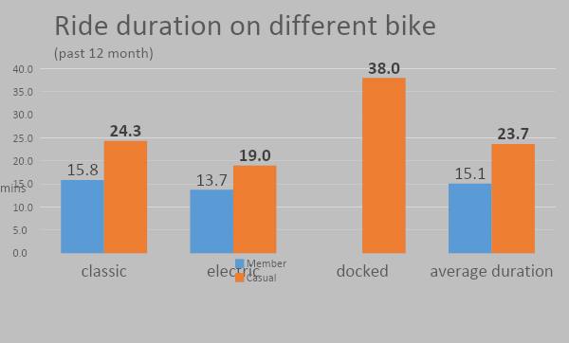
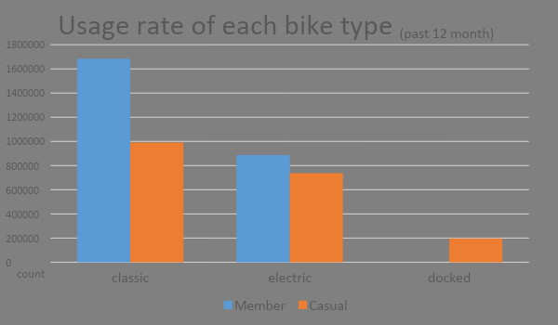
Analyze – Ride Duration / Bike Type
Compare to members, casual rider have a longer ride duration though out every category, this can mean that they might cover longer distance.
Another thing worth mention is only casual rider use docked bike, might be because it is easier for first time/casual user to understand how it work.

Slide 22
ULT RES
Questions’ answer
Strategy and suggestion
Excepted Result

Slide 23
Answers
How do annual members and casual riders use Cyclistic bikes differently?
Why would casual riders buy Cyclistic annual memberships?
How can Cyclistic use digital media to influence casual riders to become members?

Slide 24
How do annual members and casual riders use Cyclistic bikes differently?
We learn that casual riders:
Ride on weekend, around 12 pm to 7 pm.
Have longer ride, average about 35 - 40 mins.
They don’t ride as often as members,
Likely to use the bike for only one way trip. All of these indicates that casual riders use our service for recreation activities on weekend or a day off afternoon.

Slide 25
Possible identity:
Young age college / work stage people who like to spent their afternoon explore the city.
Family that will constantly going out on weekend to place like Planetarium or Aquarium.

Slide 26

Why would casual riders buy Cyclistic annual memberships?
Membership benefit
Annual fee
Normal cost
Notes:
Just like why members who use our service to commute to their job, if they use the service constantly, and the annual membership fee is very likely to be lower than the cost of using it as a casual customer, then the customer will consider becoming a member.
If we can bring out a plan that fit their needs, like a lower fee, limited ride per month plan, people may want to become a member.

Slide 27


Digital media strategy
Member-like rider
Recreational rider

Slide 28
Member-like rider
New options
Scheme
Monthly pass
Family plan
Membership benefit
Coupon
Discount
Notes:
we should promote put out a new membership plan for people who might not use the service as often. This will fit better for the needs of our target people.
For example:
Monthly pass that allow member to use it for certain amount of times per month. Family plan that allow plan owner to use for multiple people at the same time. Membership benefit providing discount for ticket to Aquarium, and information for bike location and condition.

Slide 29
For Recreational Rider
We should target people who have a habit of doing outdoor activities on their day off. With…
Advertisement on social media promoting our service using short video showing a casual afternoon tea, coffee or picnic.
Host a reward event to encourage users to post and share their ride using our hashtag.
Posting a weekly suggestion on where to go with a bike on our social media page.

Slide 30
Suggestion
Docked V.S. No Docked
Notes:
No-docked bike is a good way to cut cost especially with it’s usage rate dominating, but docks are still necessary for new coming customer and for busy location. We should set up a data set to keep track of regional bike use so we can remove unused dock and move it to expose our service to new group of customer

Slide 31
Result Expectation
Since we don’t have exact number of casual rider, we will use percentage to calculate.
If we can reach to about 20 times our current customer amount of potential customers with 5% conversion rate, and 15% becomes a member, we will have a 20% growth in membership, plus more casual rider.

